Slide 1
Bengaluru
Transport Dashboard

Slide 2
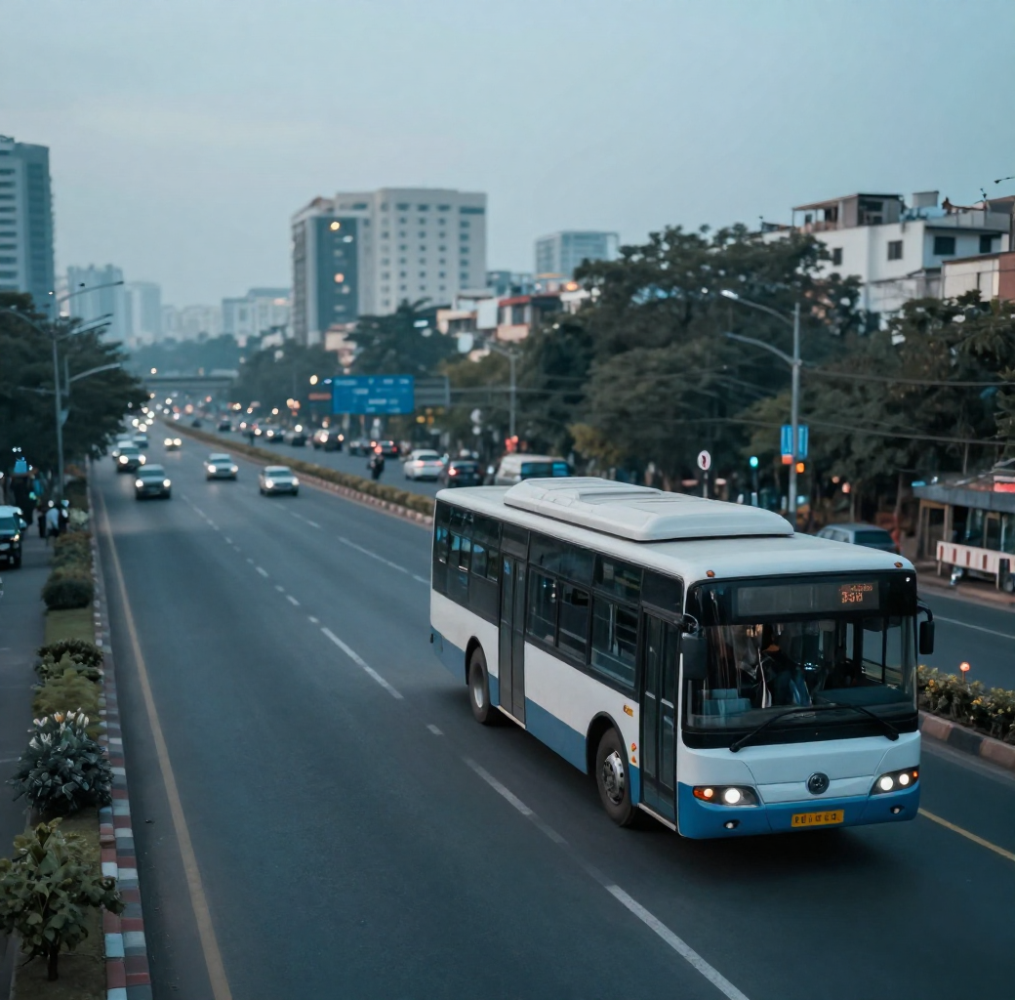
Project Overview
This project analyzes Bengaluru's public transport network to uncover patterns in routes, passenger volumes, stop distribution, trip frequency, and travel direction.
The goal is to transform raw transit data into actionable insights using data cleaning, exploratory analysis, and interactive Power BI visualizations — supporting smarter, data-driven urban mobility decisions.

Slide 3
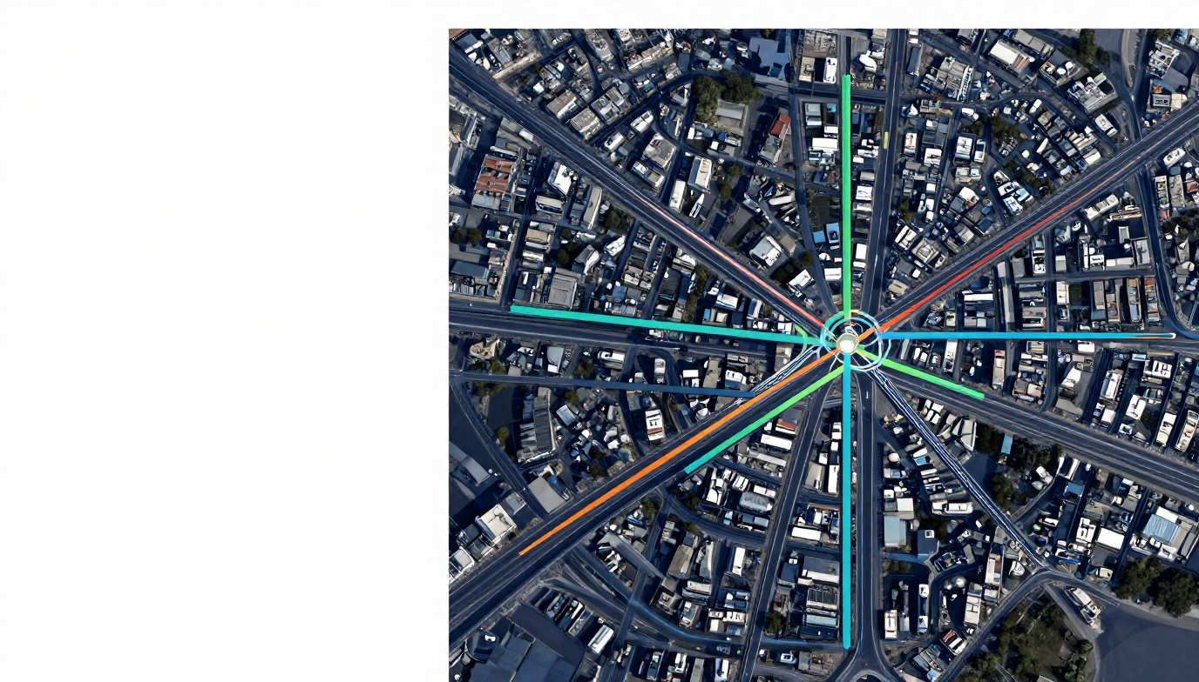
Problem Statement
Route & Passenger Challenges
Unclear route coverage
Inconsistent passenger data
No demand-based analysis
Stop, Trip & Direction Issues
Uneven stop distribution
Irregular trip frequency
No direction-wise insights

Slide 4

Project
Objectives
01/
Understand Dataset
03/
Analyze Transport
Collect and explore route, passenger, stop and trip records from the Bengaluru transport dataset.
Compute key transport measures including passenger counts, trip frequency and stop distribution.
02/
Clean & Prepare
04/
Visualize in Power BI
Remove inconsistencies, handle missing values and prepare clean data ready for analysis.
Build an interactive Power BI dashboard to present findings through charts and KPI visuals.

Slide 5
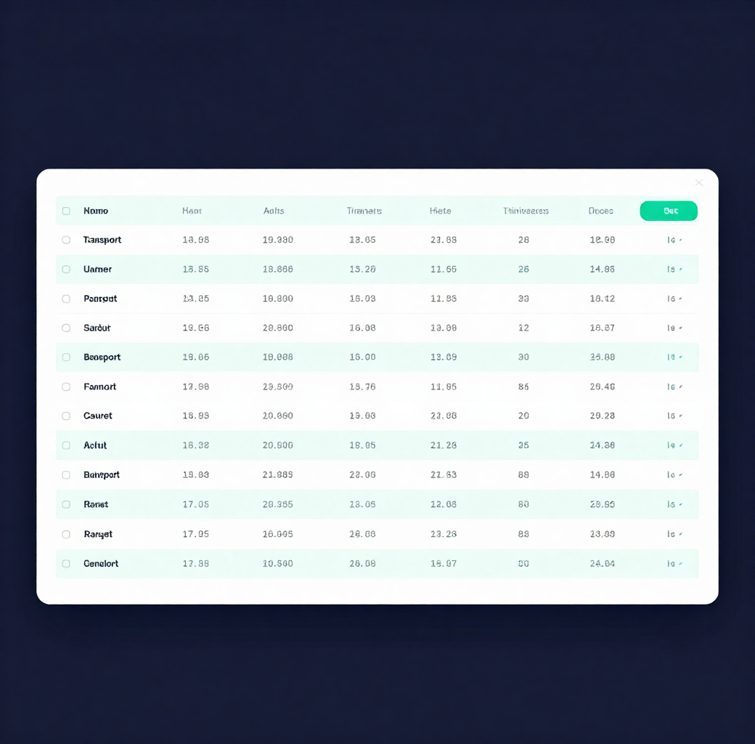
Dataset
Overview
Key Fields in the Dataset:
• Route Number – Unique identifier for each bus route
• Passenger Count – Total passengers per route/trip
• Stop Count – Number of stops along each route
• Trip Count – Total trips made per route
• Direction ID – Inbound or outbound direction indicator

Slide 6

Data Cleaning
01/
Raw Data
03/
Cleaning Steps
Imported raw BMTC dataset with Route Number, Passenger Count, Stop Count, Trip Count and Direction ID fields.
Removed duplicate rows, corrected inconsistent entries, handled missing values and standardised field formats.
02/
Validation
04/
Clean Data
Checked for null values, out-of-range counts and mismatched Direction IDs to ensure data integrity.
Analysis-ready dataset with consistent structure, no nulls and verified records loaded into Power BI.

Slide 7
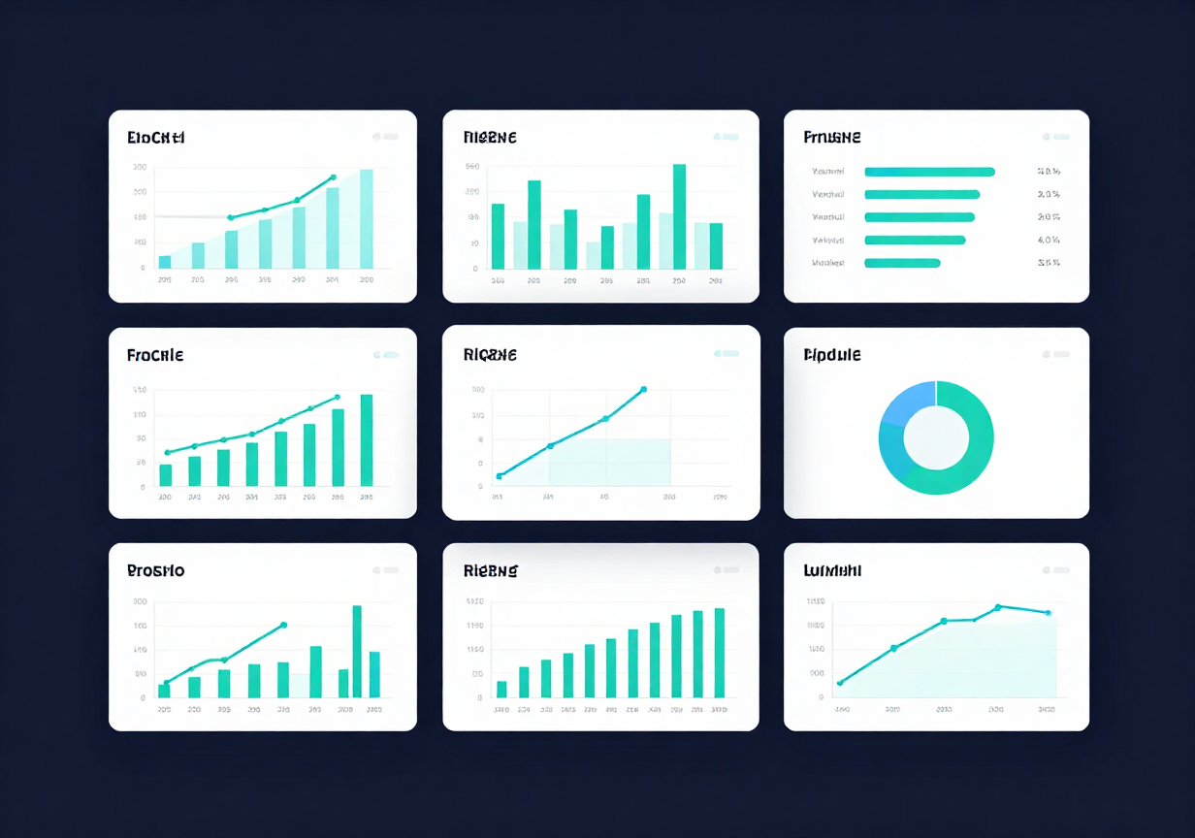
Power BI Dashboard
Overview
—
—
Total Routes
Total Trips
—
—
Total Passengers
Avg. Stops

Slide 8

Dashboard Visualizations
📊
🗺️
Passenger Analysis
Route Distribution
🚏
🧭
Stop Patterns
Direction Analysis

Slide 9

Key Insights
• Passenger distribution varies significantly across routes, revealing high-demand corridors
• A small subset of routes accounts for the majority of total trip counts
• Stop count per route influences passenger load and service frequency
• Direction ID analysis highlights asymmetric ridership patterns (inbound vs. outbound)
• Certain routes show consistently low activity, indicating optimization opportunities

